Slide 1
Book Review by
Prof. Bholanath Dutta
The World is Flat
By
Thomas Friedman

Slide 2
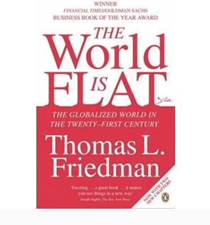

Slide 3
BOOK DETAILS
Author : Thomas L. Friedman
Country : United States
Language : English
Subject(s) : Globalization
Publisher : Farrar, Straus and Giroux
Released : April 5, 2005
Media Type : Print (Hardcover and Paperback) and Compact disc
Pages : 488
ISBN : 0-374-29288-4

Slide 4
The World Really Is Flat!
By “flat,” Friedman isn’t referring to the physical nature of the planet (in Columbus’s time, the world was physically flat — at least that’s what they thought), but rather to the global marketplace. Technological advances and the Internet have leveled the competitive landscape so that anyone anywhere can compete — the good, the bad, and the ugly can all get into the game.

Slide 5
Globalization
According to Friedman, human history has seen three major periods of globalization:
1. The first period started with Columbus’s trip to the New World and was characterized by demonstrations of power and imperialism.
2. The second period began in about 1800 and went to 2000. This period was exemplified by the growth of multinational companies and the decline in transportation and communication costs, which enabled goods to be traded globally more affordably than ever before.
3. The third period — going on now — is about shrinking the planet, flattening it, and giving individuals the power to compete and collaborate on a global level.

Slide 6
Flattening of the World
Friedman also named ten factors that have brought about this flattening of the world in the third period:
1. The fall of the Berlin wall in 1989: Tipped the balance of power toward democracies and free markets — that’s good for business!
2. Netscape’s public offering in 1995: Brought the Internet to the masses and made it possible for companies such as Amazon, Google, and eBay to start and grow to an enormous size.
3. Workflow software: Enabled communication and collaboration world-wide — that’s why you can now work from home (called telecommuting).
4. Open Source software: Inspired self-organizing teams and community collaboration around a common objective.
5. Outsourcing: Enhanced the economies of developing countries by giving companies a way to reduce their cost of doing some business functions such as manufacturing.

Slide 7
6. Moving offshore: Increased the ability to compete globally as companies began putting offices and plants in other countries.
7. Global supply chains: Connected the world in a massive value chain.
8. Insourcing: Made it possible for small businesses to gain the competencies of much larger companies.
9. Web search engines: Brought information to anyone, anywhere, any time.
10. Digital and wireless: Enabled 24/7 connectivity and virtual collaboration.

Slide 8
In Fine……
Many of these flatteners have been around for a long time. Individually, each is powerful, but it’s the convergence of these ten at this point in time that has created sufficient critical mass to flatten the world, making everything and everyone accessible to anyone.
And what does a flattened world look like? Friedman talks about visiting Bangalore, India, and being startled by Pizza Hut billboards; glass-and-steel buildings with familiar names such as Texas Instruments, IBM, and Microsoft; and people who speak English with a perfect California accent (if such a thing exists)

Slide 9
THANK YOU

